Slide 1
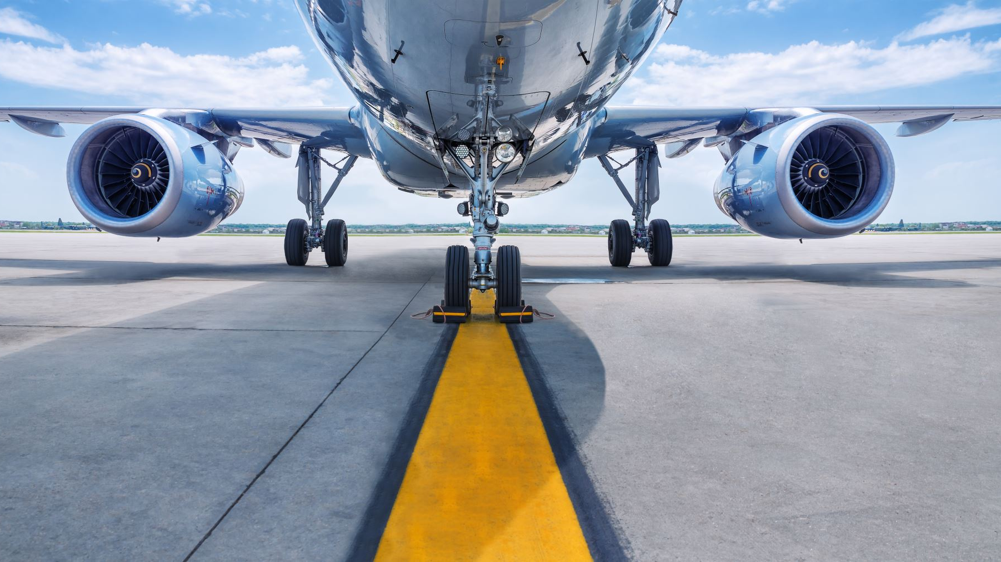
Aviation Safety Margins
Application to Aircraft Operations

Slide 2


Takeoff Example
Aircraft Rotation: 100 knots
Acceleration: 25 knots per 1,000 feet
Deceleration: 25 knots per 1,000 feet
25 knot headwind
= 1,000 feet
10,000 feet
Rotation
Safety Margin
Abort Distance
Takeoff Roll

Slide 3
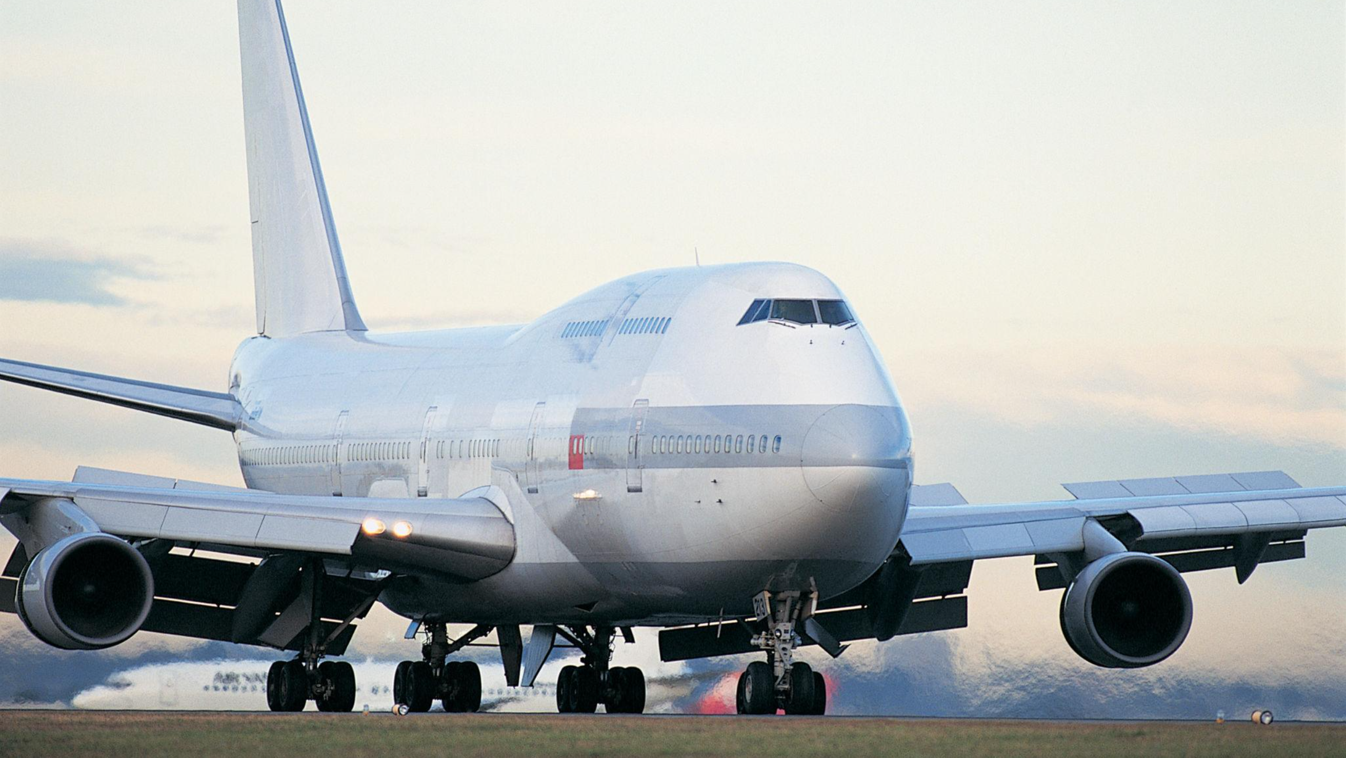
Takeoff Example
Aircraft Rotation: 100 knots
Acceleration: 25 knots per 1,000 feet
Deceleration: 25 knots per 1,000 feet
No wind
= 1,000 feet
10,000 feet
Rotation
Safety Margin
(reduced by 50%)
Abort Distance
Takeoff Roll

Slide 4
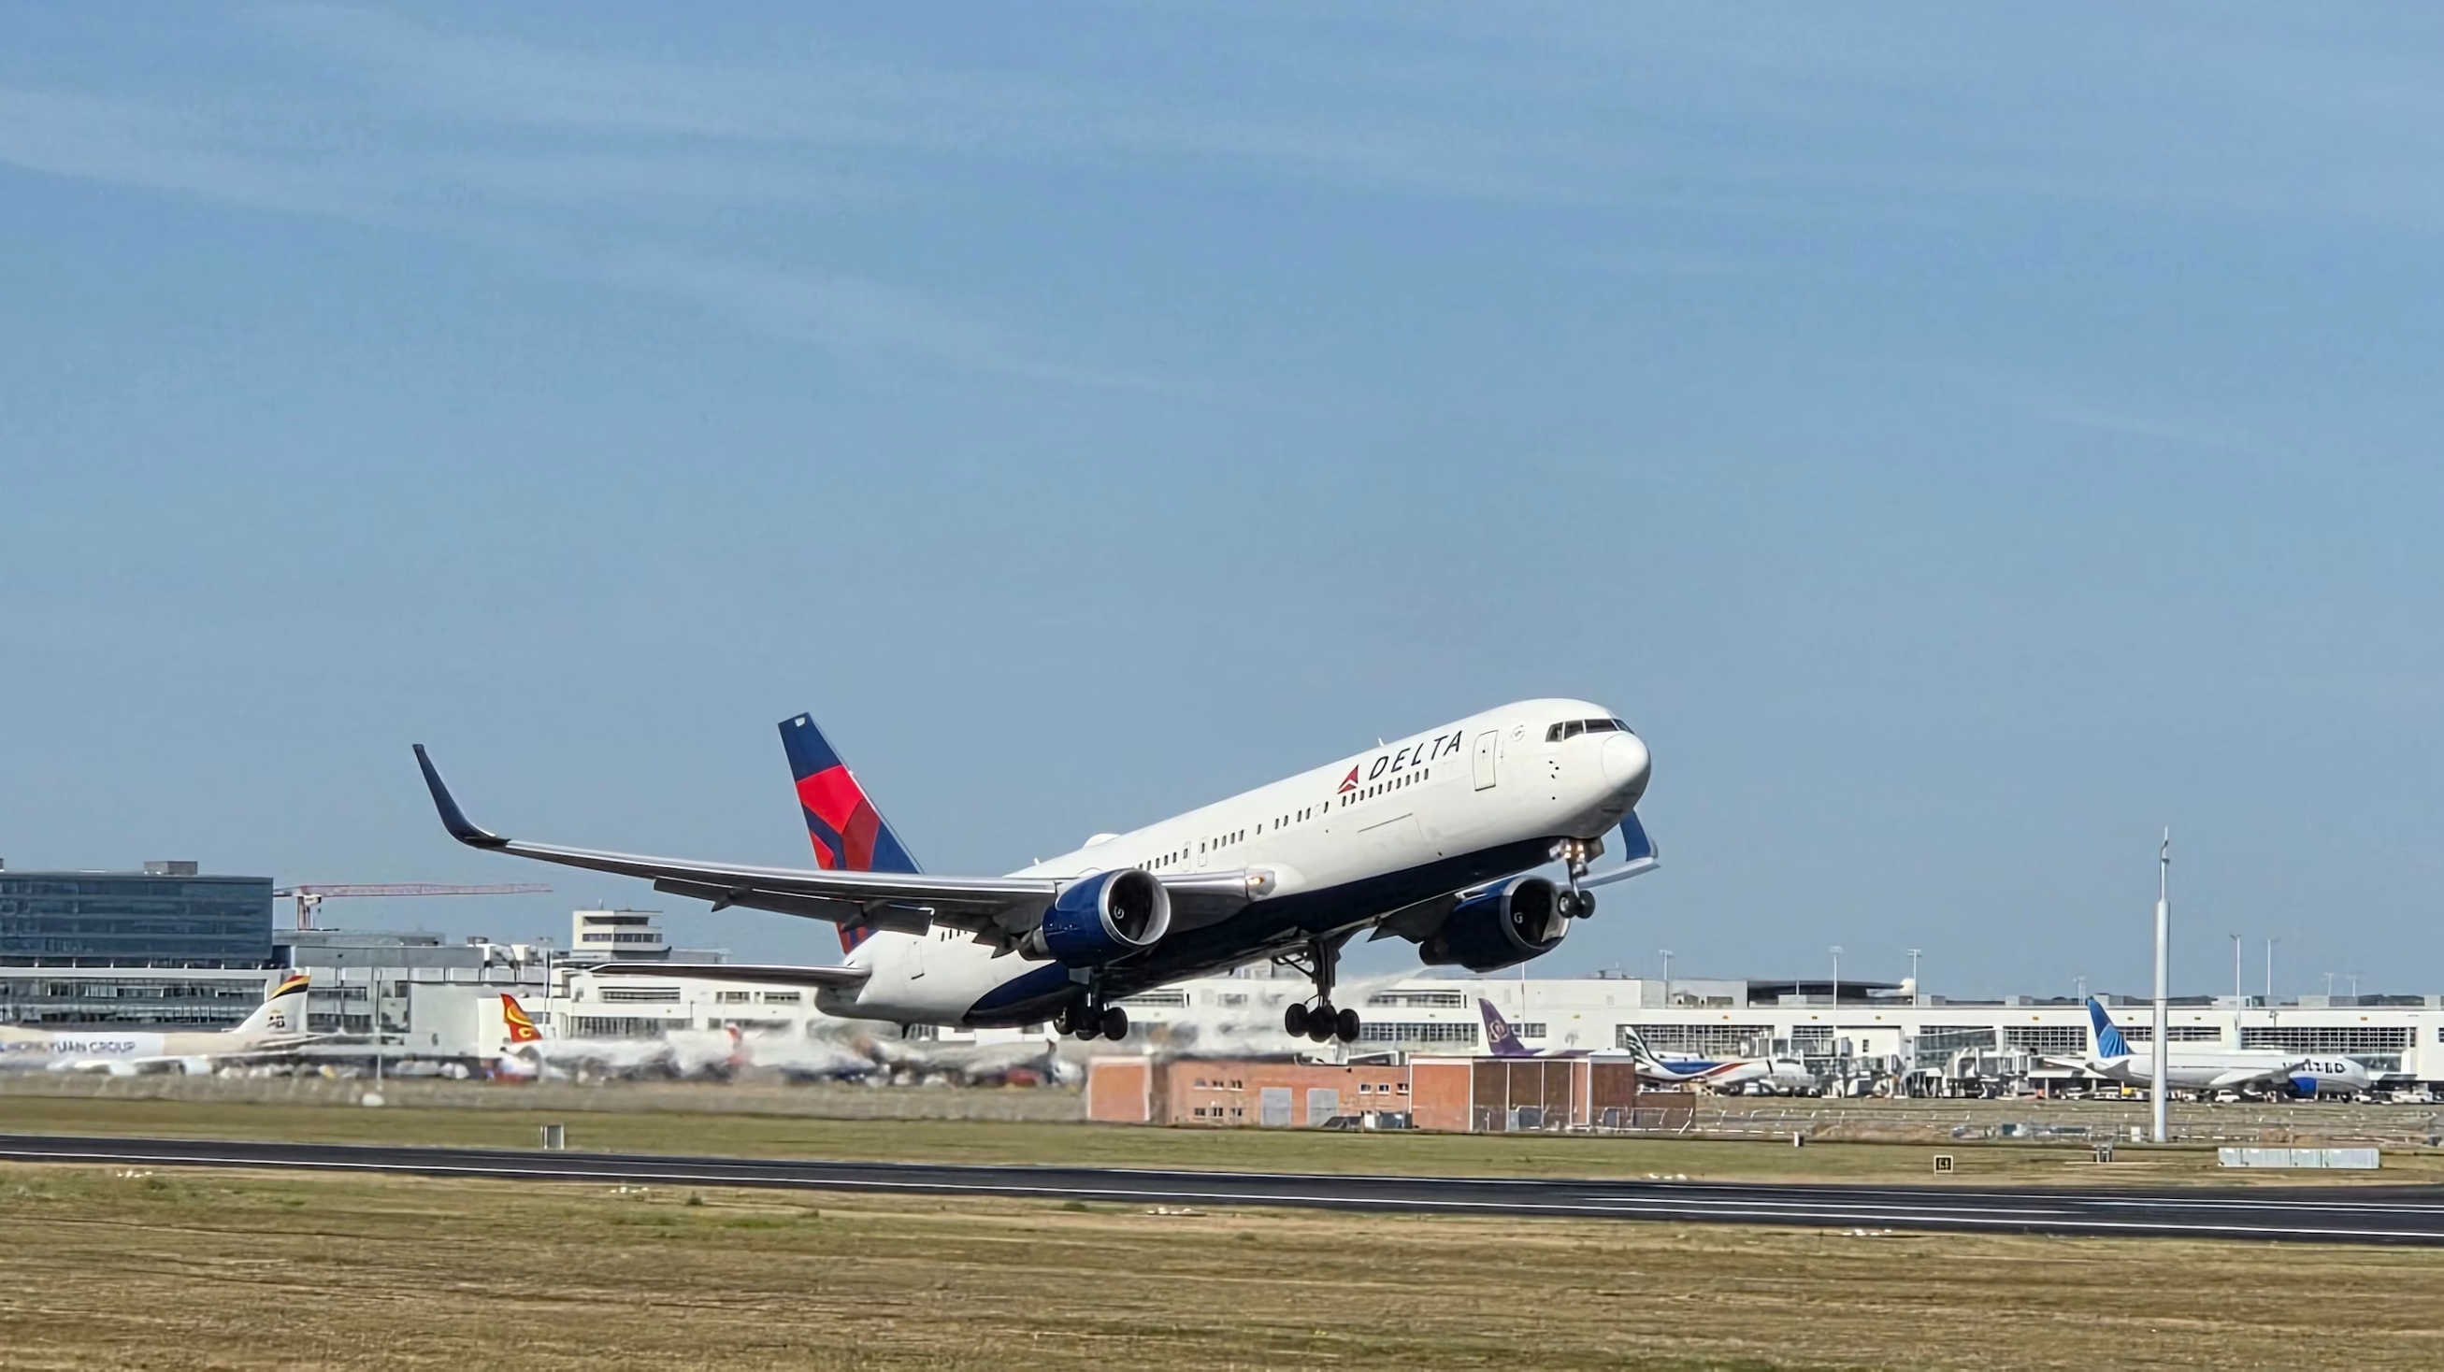
Takeoff Example
Aircraft Rotation: 100 knots
Acceleration: 25 knots per 1,000 feet
Deceleration: 25 knots per 1,000 feet
No wind
= 1,000 feet
8,000 feet
Rotation
No safety margin
(safety margin depleted)
Abort Distance
Takeoff Roll

Slide 5
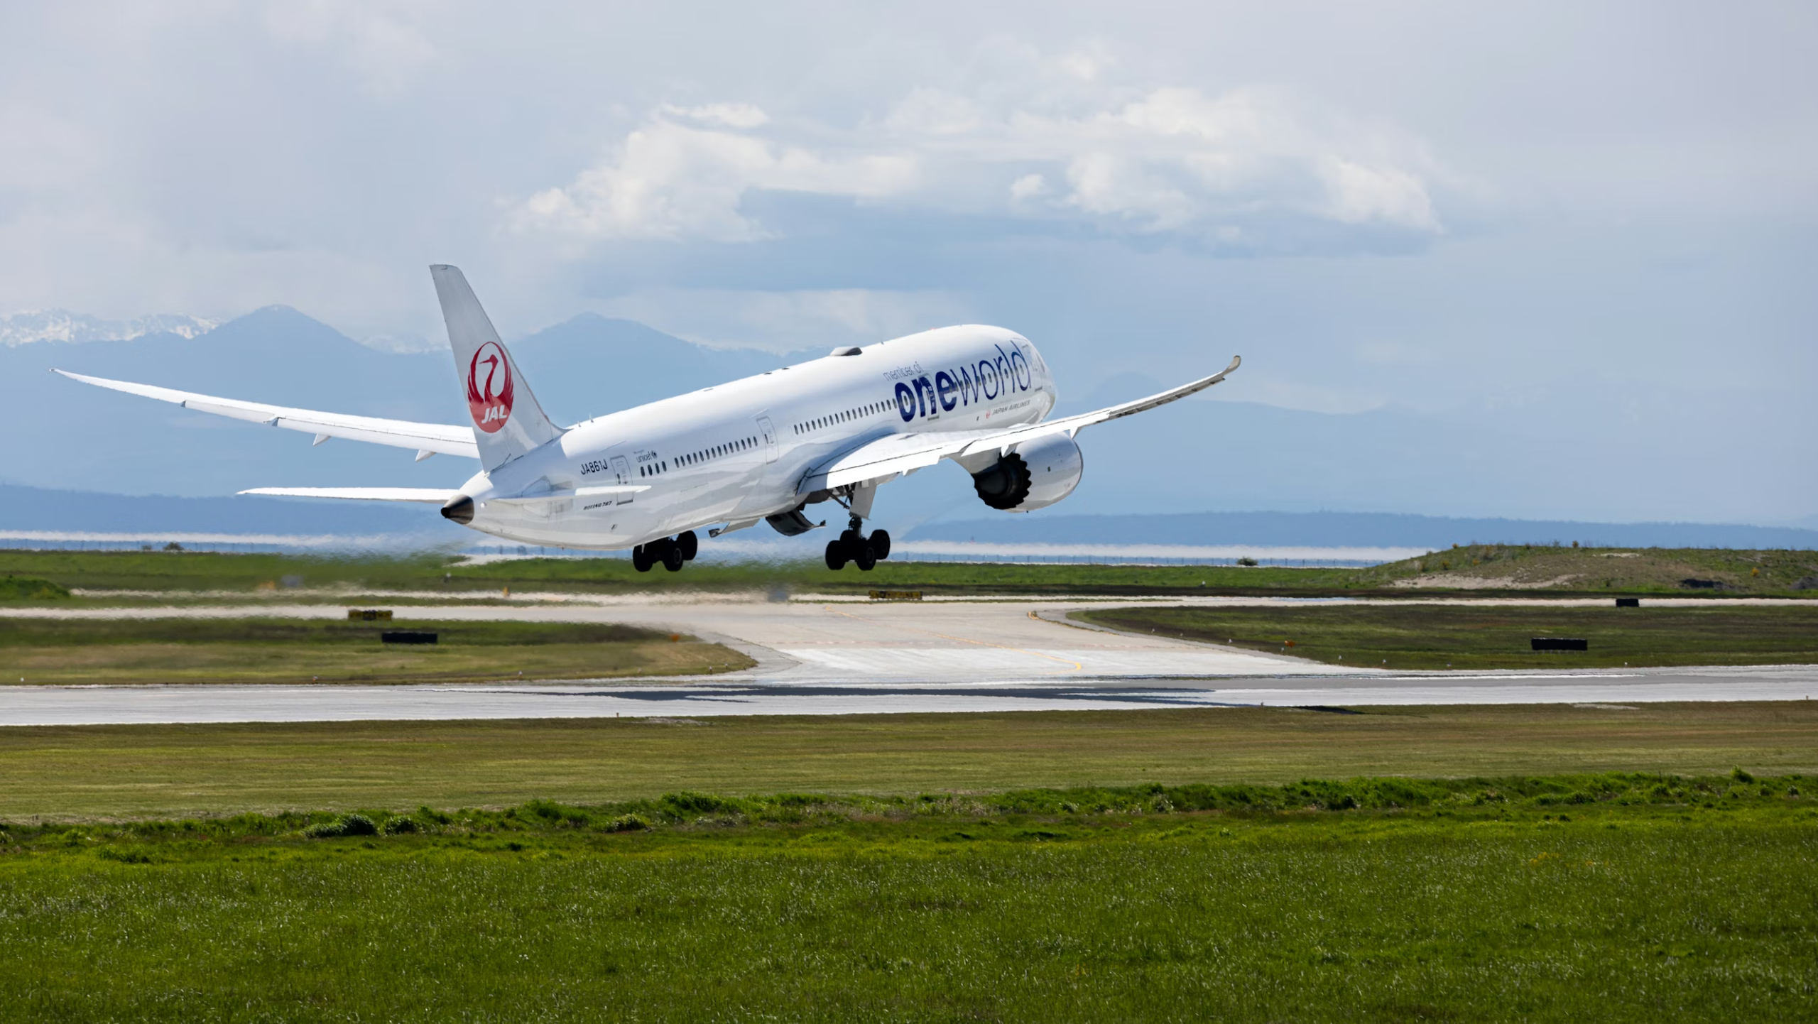
Takeoff Example
Aircraft Rotation: 100 knots
Acceleration: 25 knots per 1,000 feet
Deceleration: 25 knots per 1,000 feet
No wind
= 1,000 feet
6,000 feet
Rotation
Negative safety margin
Abort Distance
Takeoff Roll
Abort Distance
Refusal Speed

Slide 6
